Slide 1
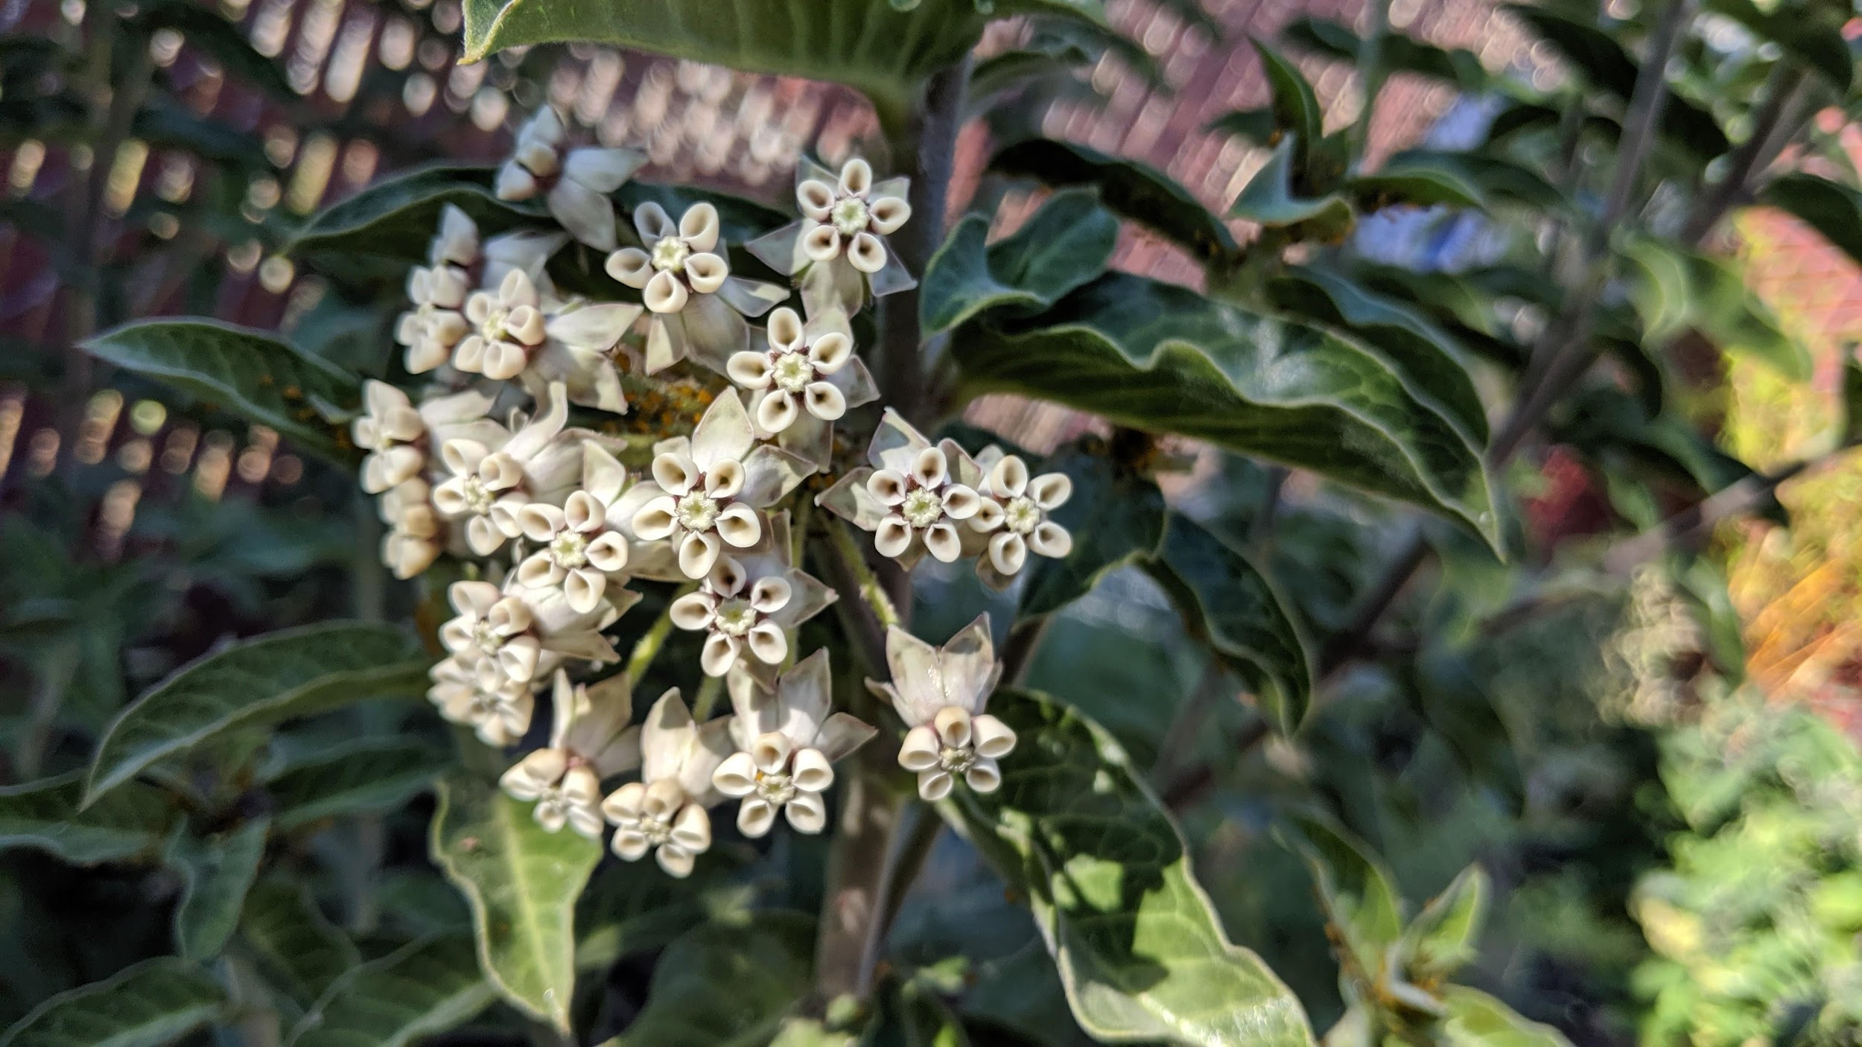
MontyBot
A Gardening Chatbot - Final Capstone - Nathalie Ries

Slide 2
Table of Contents
01
About the Project
04
Building the ChatBot
02
Topic Modeling
05
Improvements
03
Text Summarization
06
Future Developments
Why and how I decided to do this project
Deep learning model
LDA on questions
What I can do to improve this bot
Extractive approach on answers
Ideas on enhancements

Slide 3
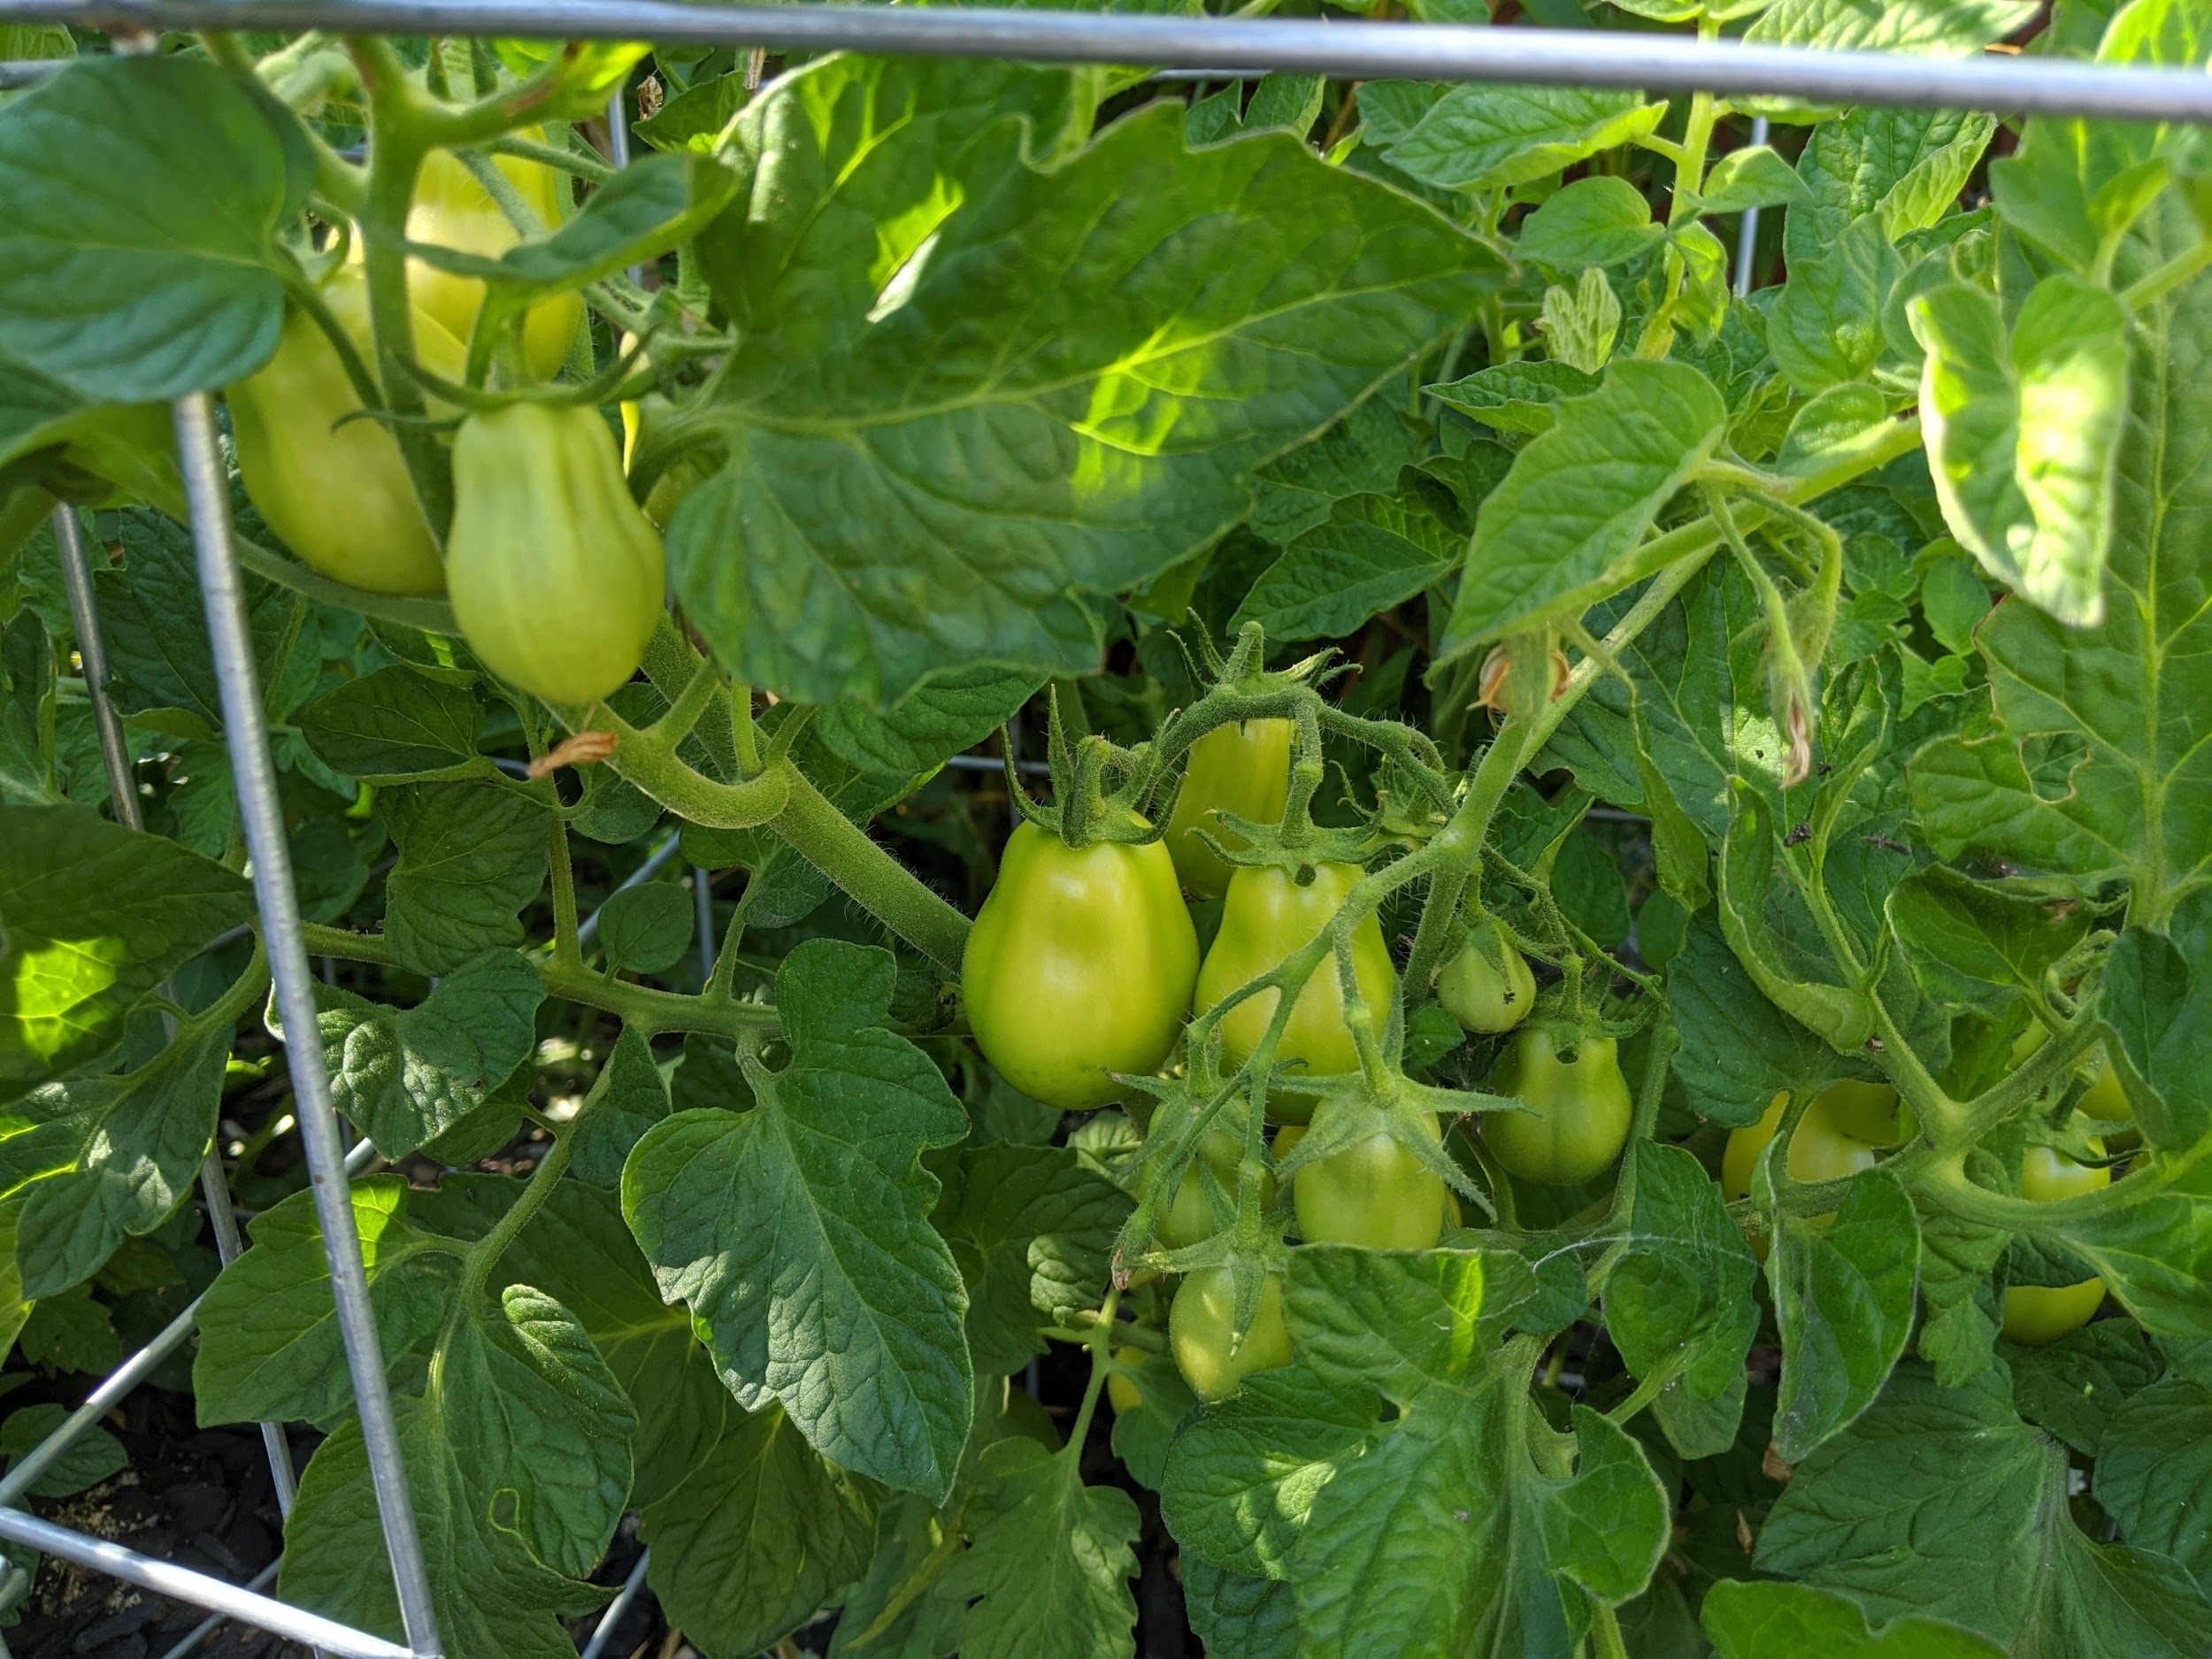
01
About This Project

Slide 4
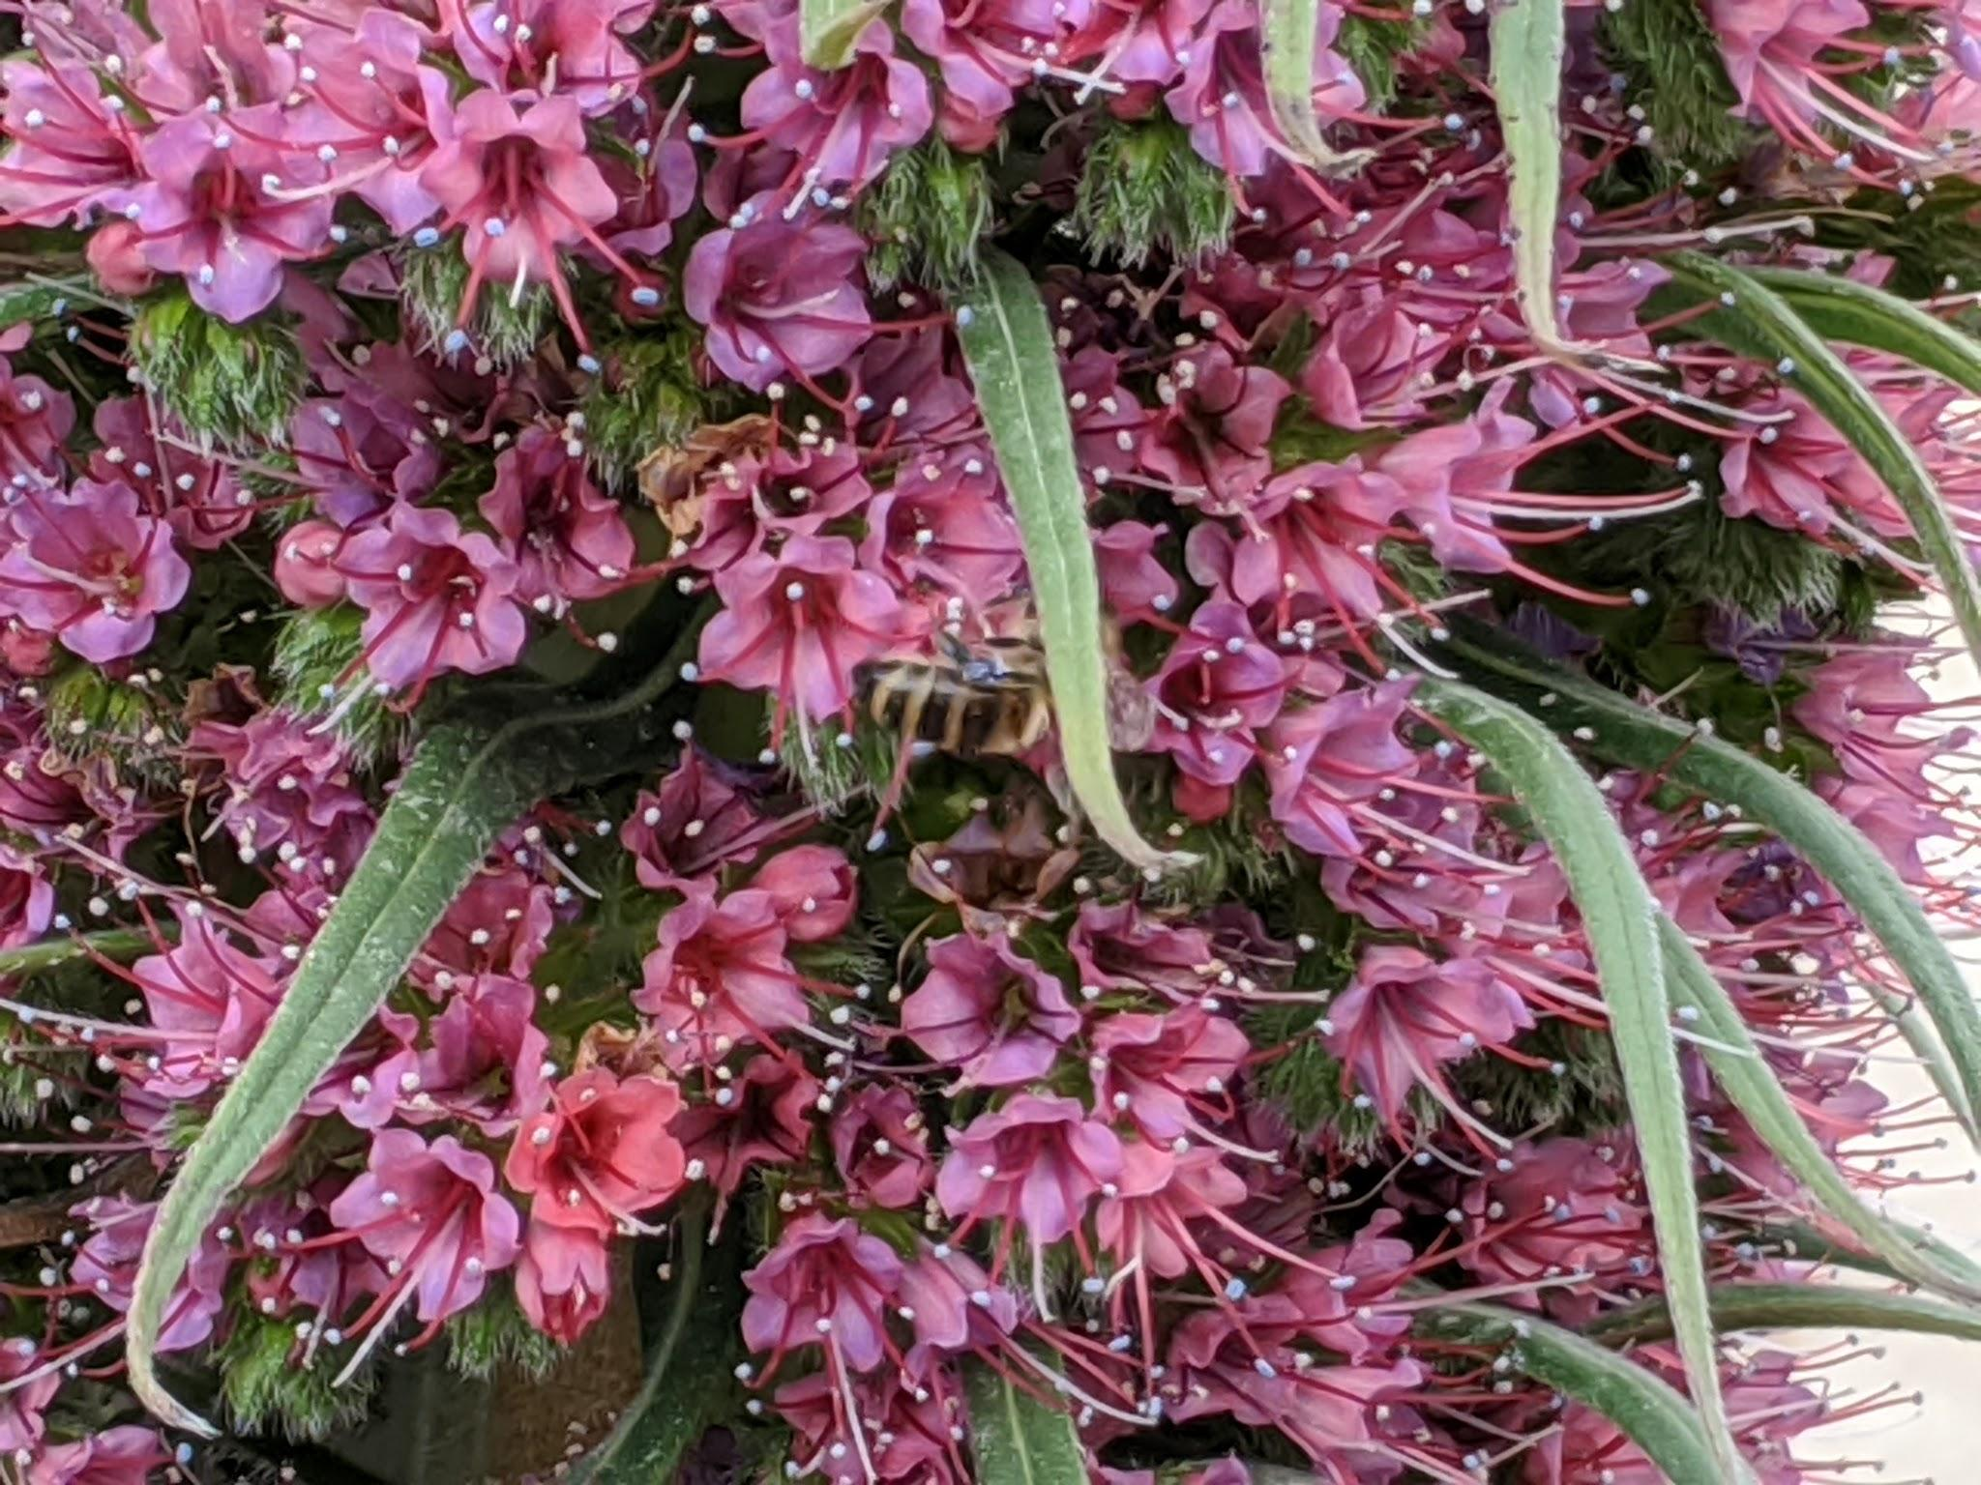
A passionate gardener
I am deeply passionate about gardening and growing my own fruits, vegetables and culinary herbs. I have often found myself in distress when a plant of mine looks ill or in search of best practices for growing certain crops.

Slide 5
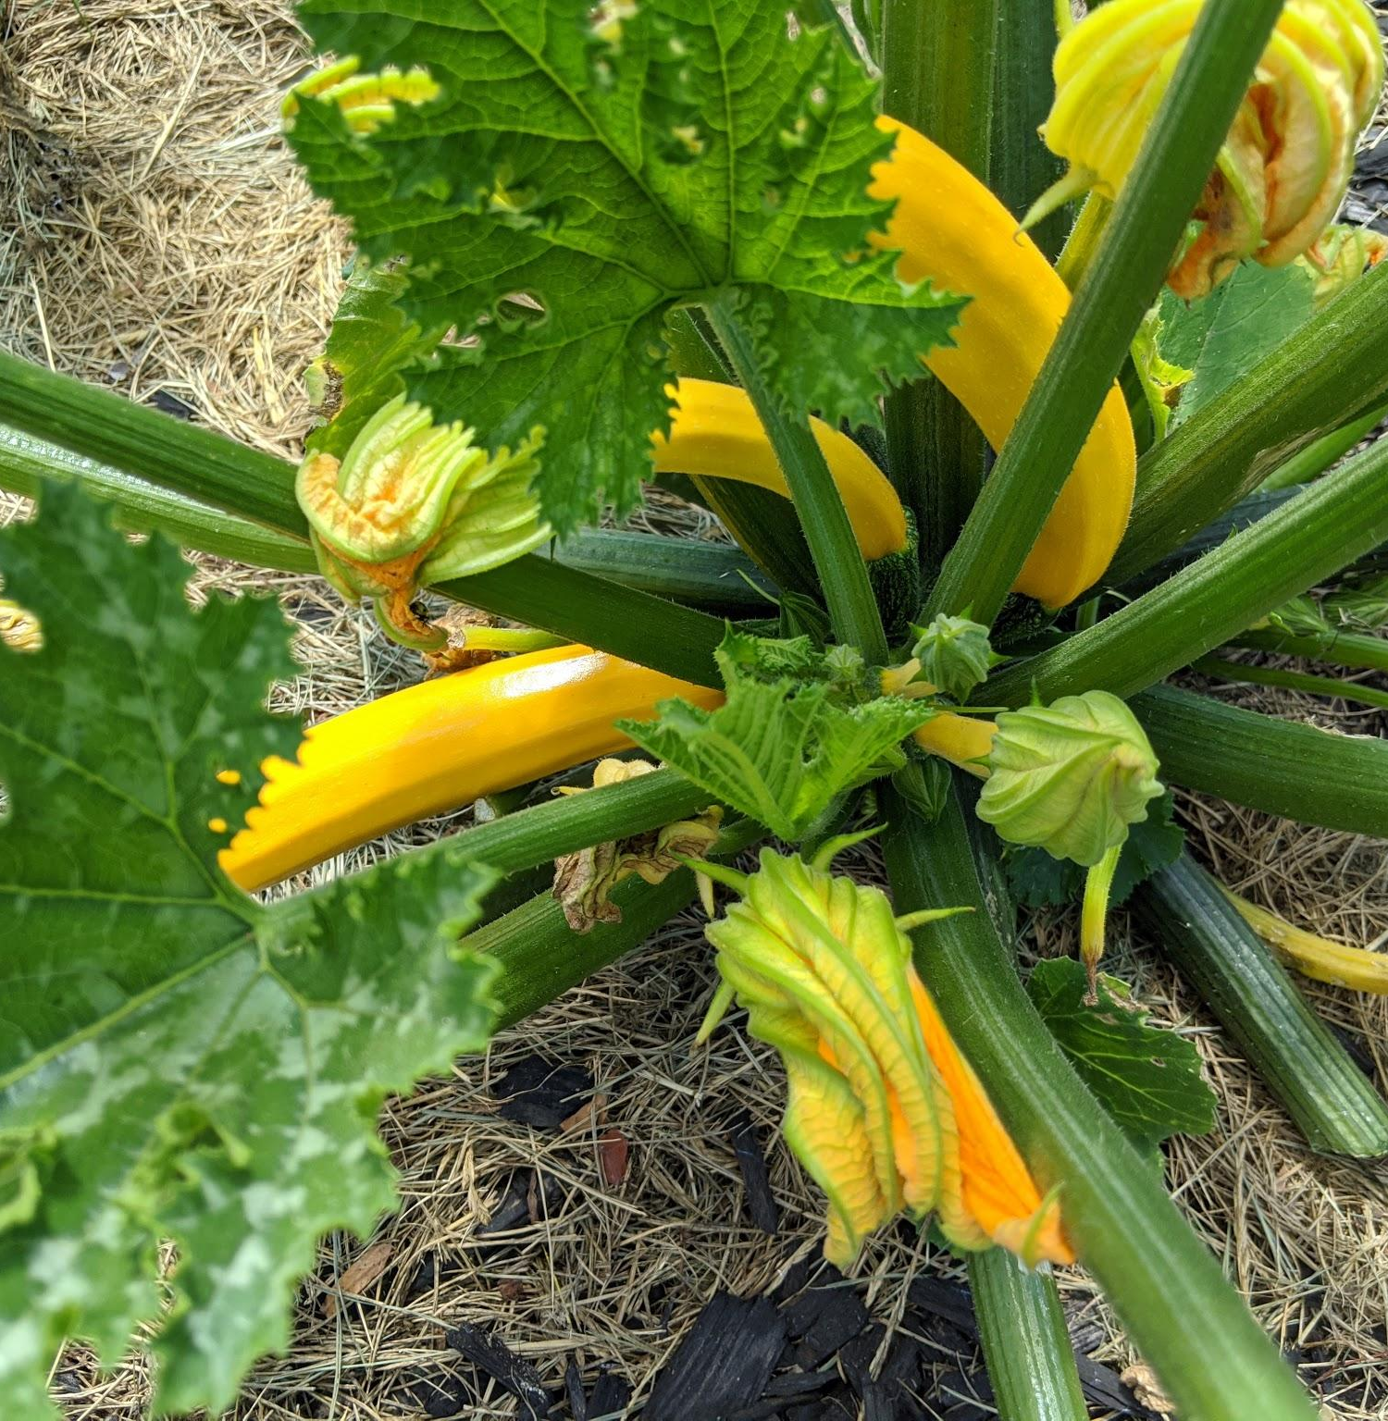
The Opportunity
Since the beginning of the pandemic, people have taken an increased interest in their gardens. Seed companies have run out completely of their inventory and victory gardens started popping up all around the country.
A gardening assistant could help many around the world.

Slide 6

Why “MontyBot”?
Monty Don is a world famous gardener from England who’s been hosting gardening shows and writing gardening books for the last 20 years. He’s one of the personalities that I admire the most in the field.

Slide 7
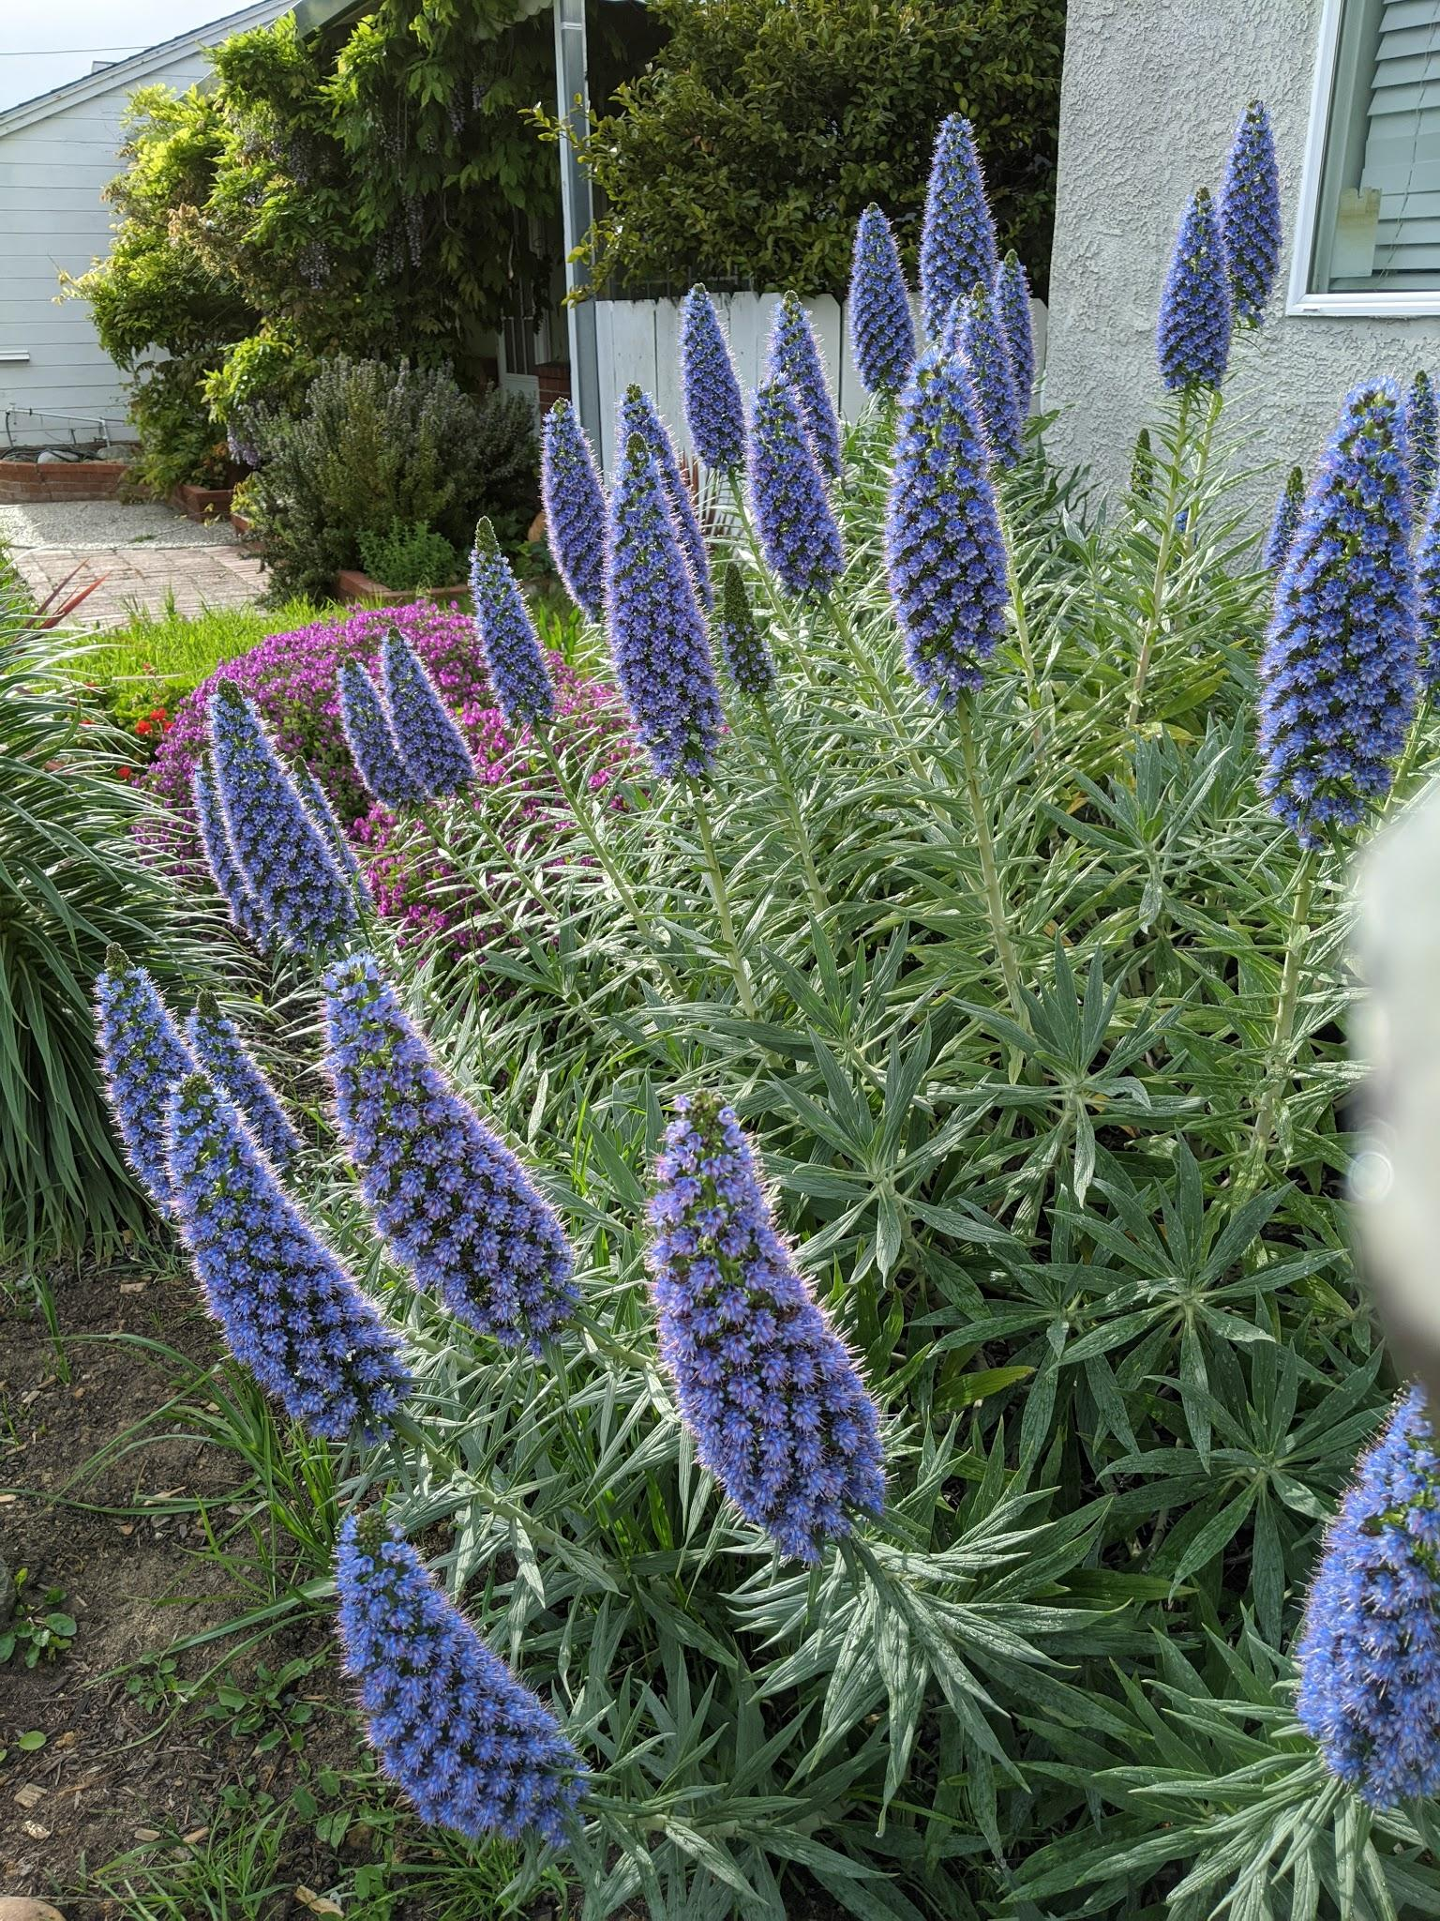
The Data
I scraped 21.5k questions along with their answers from the gardening blog on houzz.com. I then combined all answers under one column. Before beginning the first step I had 3 columns:
The title question
The body of the question
The answer
After removing all questions that had no answers, I had a working data set of 17,177 rows.

Slide 8
The Process
Topic Modeling
Building the Chatbot
YEAR 1
YEAR 1
YEAR 3
YEAR 4
Step 0
Step 1
Step 2
Step 3
Scraping the data, removing observations with no answers
Text Summarization

Slide 9
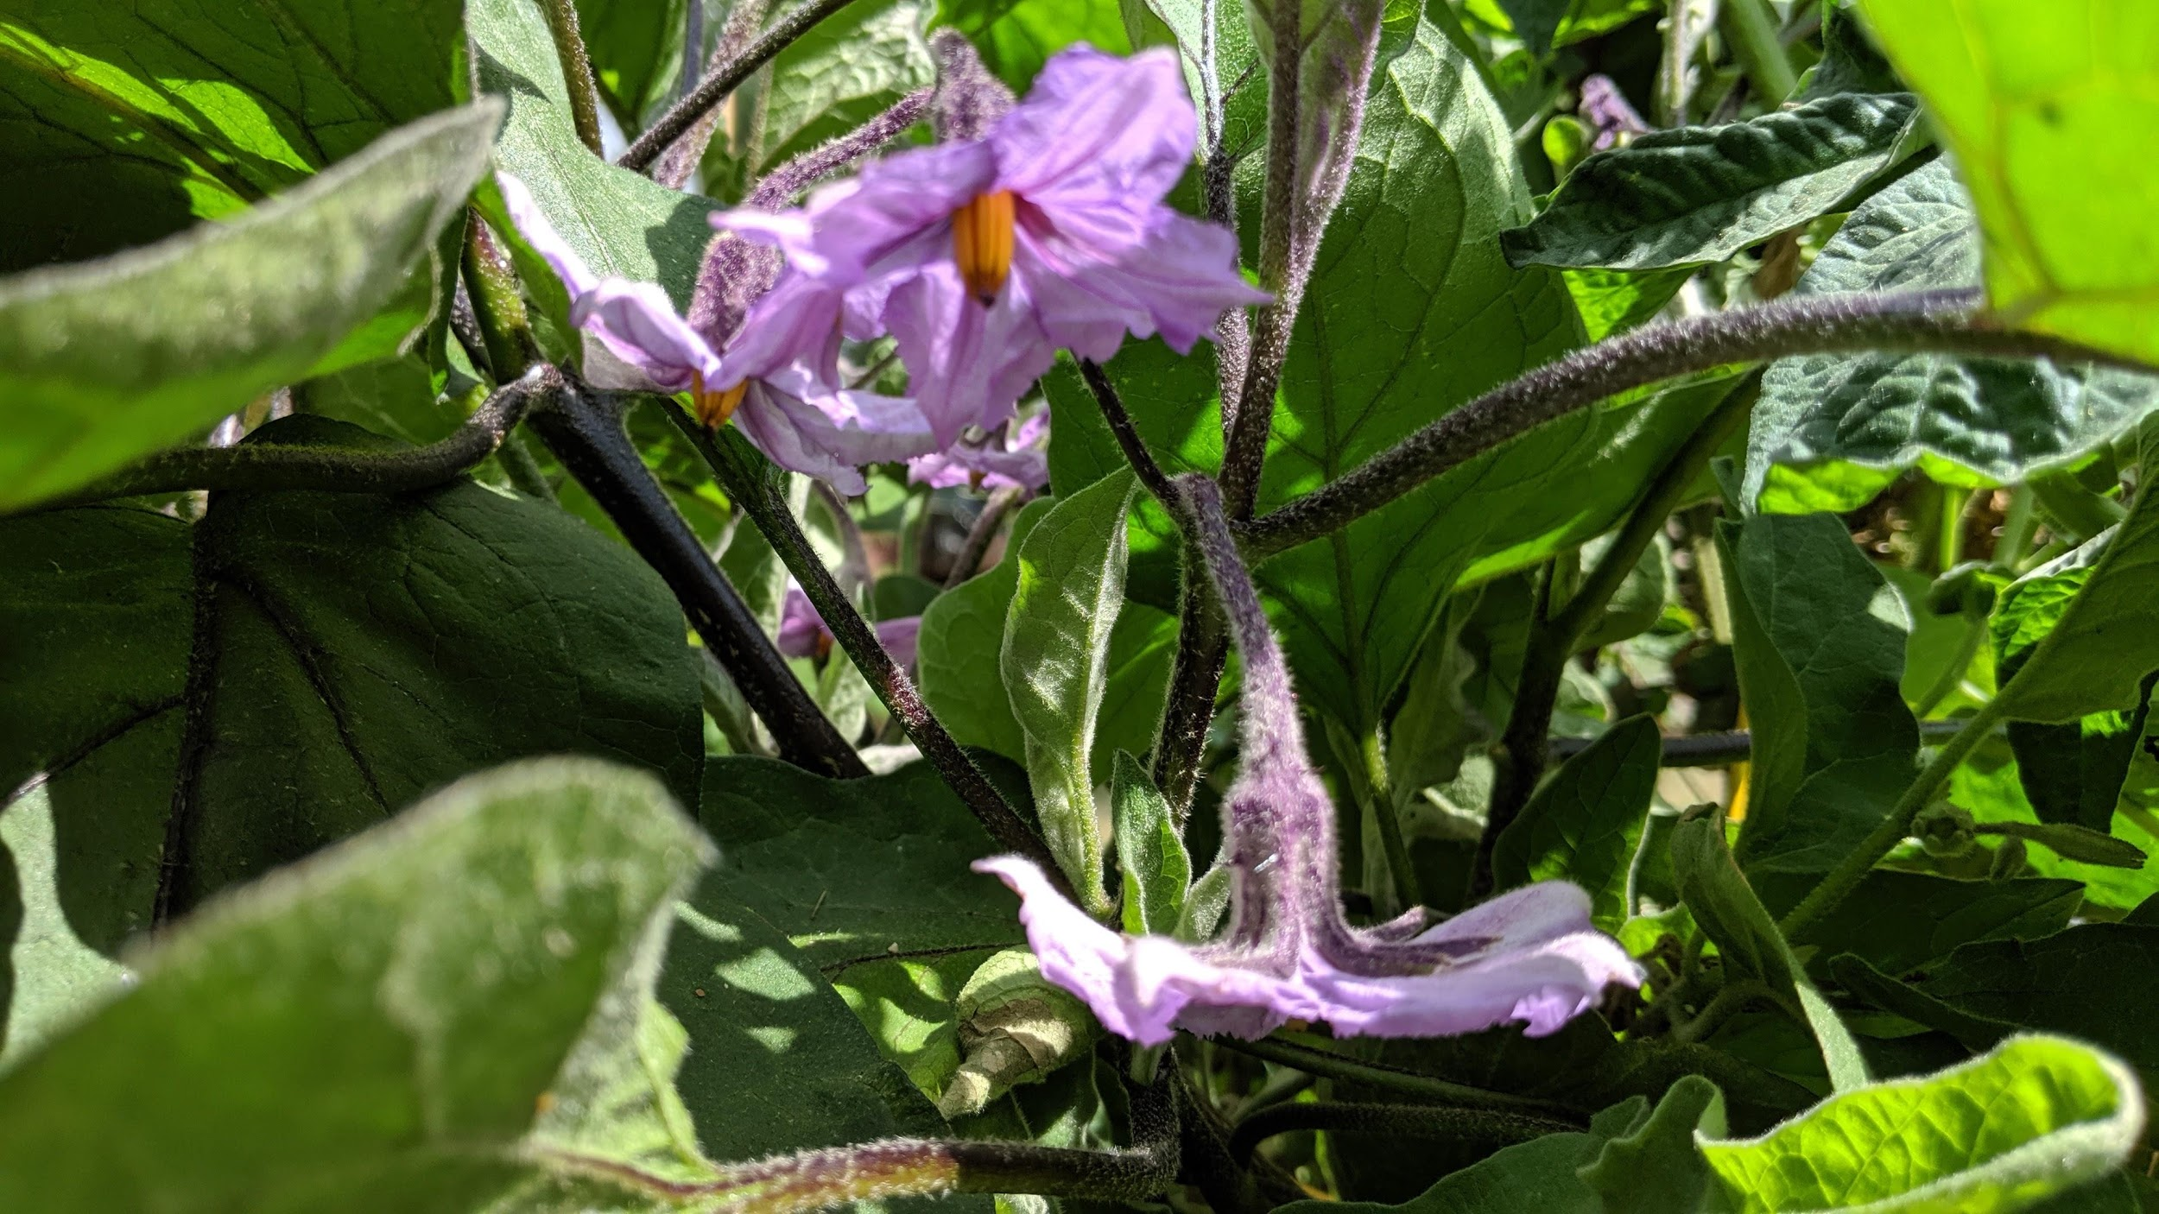
02
Topic
Modeling

Slide 10
Topic Modeling
Topic modeling is an unsupervised machine learning technique that is capable of scanning a set of documents, detecting word and phrase patterns within them, and automatically clustering word groups and similar expressions that best characterize a set of documents.
For this part project I used the most popular topic modeling model: the Latent Dirichlet Allocation model. I used both the scikit learn LDA and the Gensim LDA. I also applied GridSearchCV to identify the best parameters on the scikit learn LDA.
I will first show my EDA results followed by the model implementations and results.

Slide 11
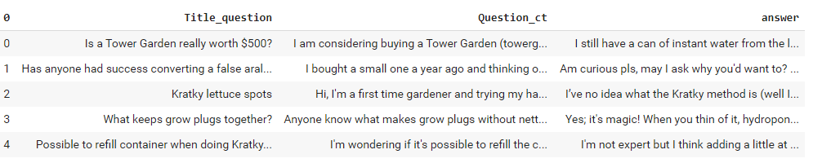
The original dataframe

Slide 12
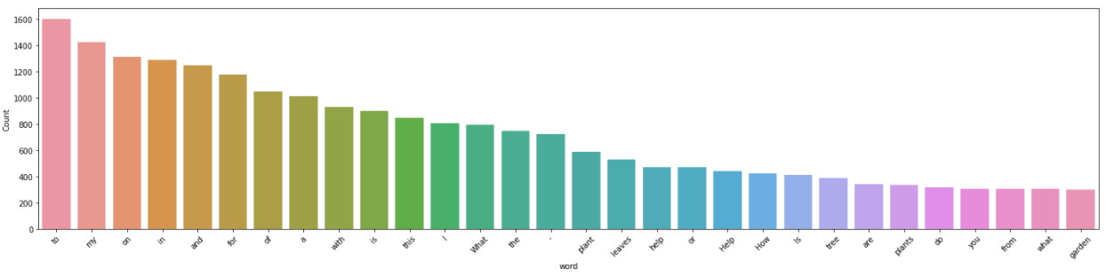
Exploratory Data Analysis
Top 20 frequent word distribution prior to text preprocessing

Slide 13
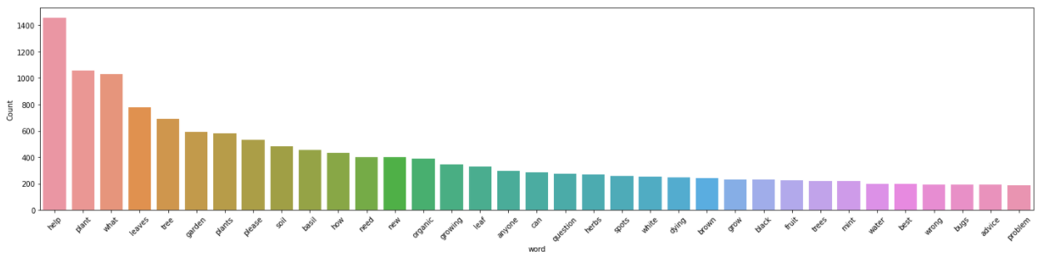
Exploratory Data Analysis
Top 20 most frequent word distribution after removing stop words

Slide 14
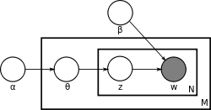
Latent Dirichlet Allocation Model
Originally proposed by Blei et al in 2003, the latent Dirichlet allocation (LDA) is a generative statistical model that allows sets of observations to be explained by unobserved groups that explain why some parts of the data are similar.
For example, if observations are words collected into documents, it posits that each document is a mixture of a small number of topics and that each word's presence is attributable to one of the document's topics.
Source: Wikipedia & Youtube Video
Notes:
With plate notation, which is often used to represent probabilistic graphical models (PGMs), the dependencies among the many variables can be captured concisely. The boxes are "plates" representing replicates, which are repeated entities, In this case the title questions. The outer plate represents documents, while the inner plate represents the repeated word positions in a given document; each position is associated with a choice of topic and word.
The variable names are defined as follows:
M denotes the number of documents
N is number of words in a given document
α is the parameter of the Dirichlet prior on the per-document topic distributions
β is the parameter of the Dirichlet prior on the per-topic word distribution

Slide 15
Setting up for the model
Step 1: Converting to list
Step 2: A few extra cleaning to remove emails, new line characters or single quotes.
Step 3: Lemmatization (process of finding the lemma of each word)
Step 4: Create the document word matrix which is required as main input by the LDA model. I used CountVectorizer. I have configured the CountVectorizer to consider words that has occurred at least 10 times (min_df), remove built-in english stopwords, convert all words to lowercase, and a word can contain numbers and alphabets of at least length 3 in order to be qualified as a word.

Slide 16
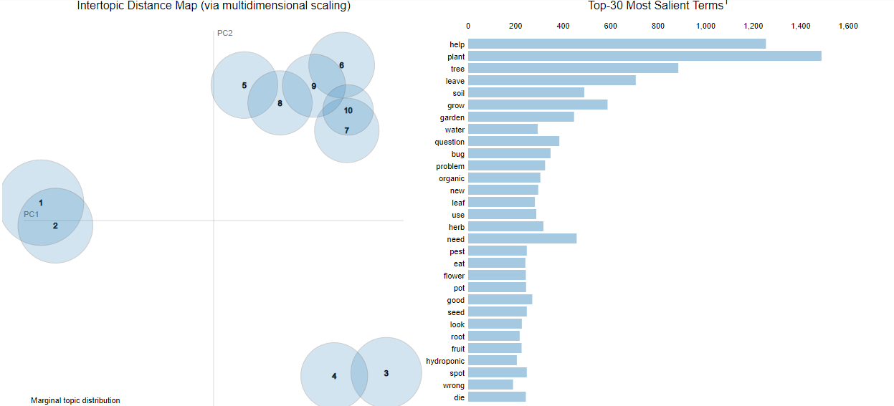
Running SKlearn LDA with GridSearchCV
A model with higher log-likelihood and lower perplexity (exp(-1. * log-likelihood per word)) is considered to be good.
The best parameters that resulted from grid search cv with n_components: [10,15,20,25,30] and learning_decay:[0.5,0.7,0.9] where 10 and 0.9 respectively
Here we see through the pyLDAvis that there is 3 groups of topics that formed.
Notes:
Learning decay=It is a parameter that control learning rate in the online learning method.

Slide 17
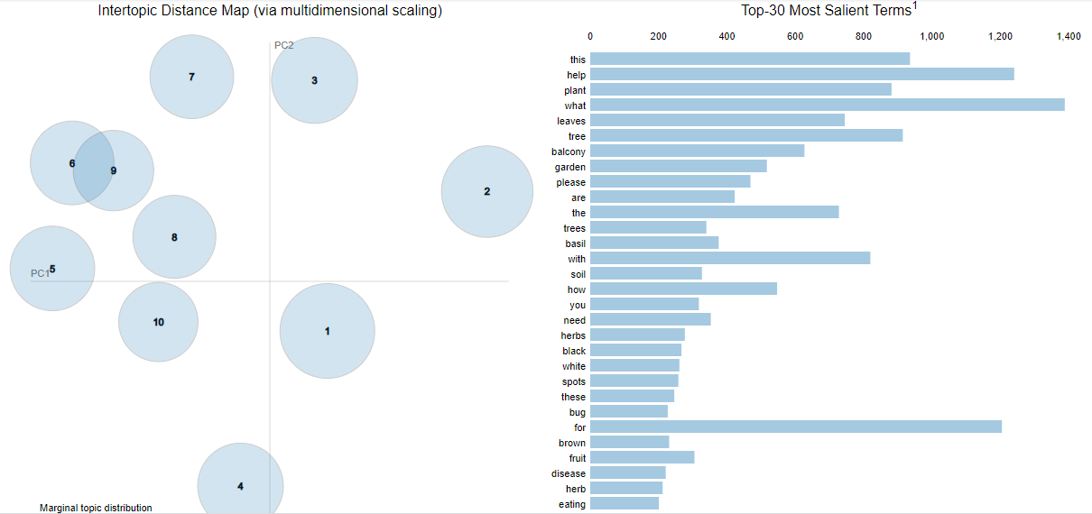
Comparing to Gensim LDA
Through my research I found that Gensim LDA can sometimes yield better results that scikit Learn’s LDA.
One of the ways to compare the 2 is by visualising the topics and see whether they are better separated.
Here we can see that the topics aren’t as clustered together as with scikit learn’s LDA.
I proceeded with this model
Notes:
Gensim is an open-source library for unsupervised topic modeling and natural language processing, using modern statistical machine learning.

Slide 18
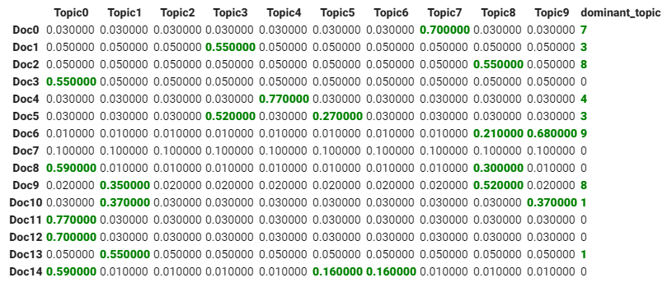
Allocating 1 topic to each question
To classify a document as belonging to a particular topic, I looked at which topic has the highest contribution to that document and assigned it.
In this illustration, I’ve greened out all major topics in a document and assigned the most dominant topic in its own column.
Notes:
Gensim is an open-source library for unsupervised topic modeling and natural language processing, using modern statistical machine learning.

Slide 19
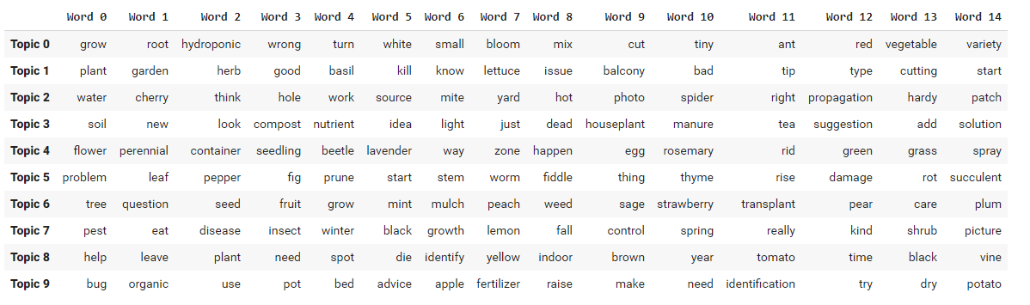
Naming each topic
Based on the top 15 key words to each topic, I individually named them. For example, Top 0 had “grow”,”root”,”hydroponic” so I labeled that topic:”Hydroponics” which is a specific growing method.
Notes:
Gensim is an open-source library for unsupervised topic modeling and natural language processing, using modern statistical machine learning.

Slide 20
Naming each topic
Based on the top 15 key words to each topic, I individually named them. For example, Top 0 had “grow”,”root”,”hydroponic” so I labeled that topic:”Hydroponics” which is a specific growing method.
Notes:
Gensim is an open-source library for unsupervised topic modeling and natural language processing, using modern statistical machine learning.

Slide 21
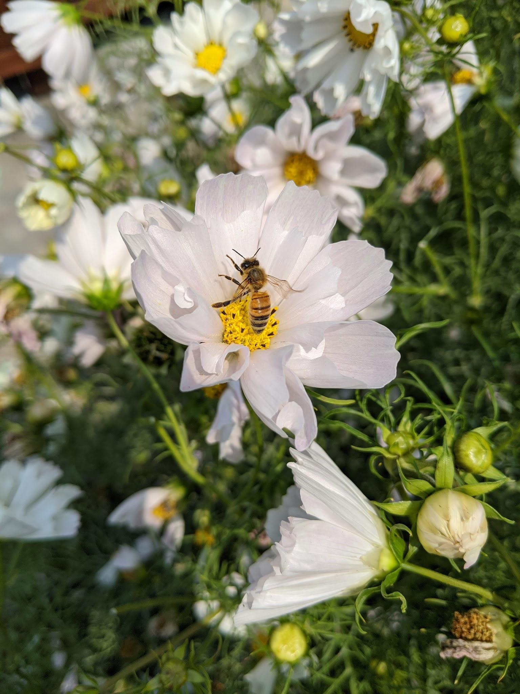
At the end of Step 1
Allocated a topic to each question
10 topics are:
Compost_Fertilization
Herb_Garden
Hydroponics
Indoor Gardening
Issue Identification
Organic Gardening
Perennial Gardening
Pest_Disease
Trees
Watering

Slide 22
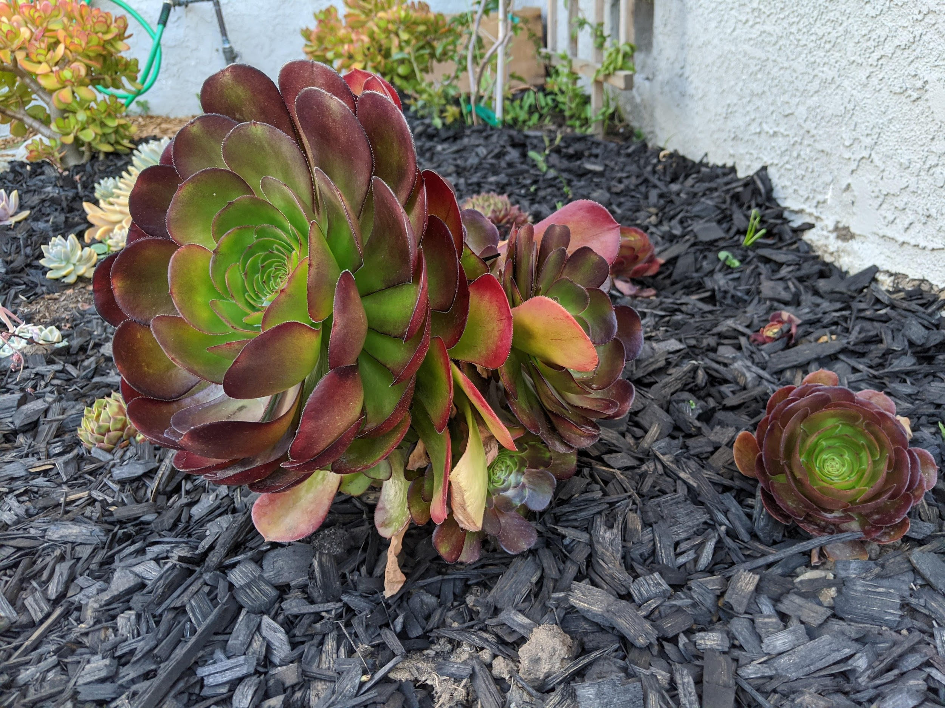
03
Text Summarization

Slide 23
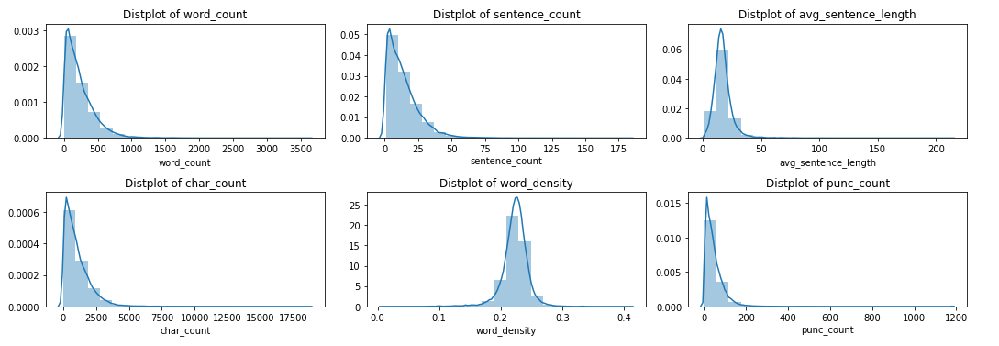
Exploratory Data Analysis
Created 6 continuous variables to explore the answer column:
Notes:
We can see that most answers average around 200 words, 13 sentences

Slide 24
Text Preprocessing
Cleaned the answers by removing:
Escape characters
If it occurs more than one time consecutively : _ - ~ + .
<>()|&©ø"';~*
mailto:
\x9* in text
Replace any url as such https://abc.xyz.net/browse/sdf-5327 ====> abc.xyz.net
multiple spaces
4% of cleaned answers have more than 700 words
2% of cleaned answers have more than 20 sentances
Vocabulary size is 131,690 words
New DF: 16,384 rows

Slide 25
Text Summarizer
Summarization can be defined as a task of producing a concise and fluent summary while preserving key information and overall meaning. Furthermore, extractive methods attempt to summarize articles by selecting a subset of words that retain the most important points.
I will be using an unsupervised learning approach to find the sentences similarity and rank them. One benefit of this will be, I don’t need to train and build a model prior to using it.
I will use textrank as an approach to rank the sentences. TextRank does not rely on any previous training data and can work with any arbitrary piece of text. TextRank is a general purpose graph-based ranking algorithm for NLP.
Notes:
Cosine similarity is a measure of similarity between two non-zero vectors of an inner product space that measures the cosine of the angle between them. Since we will be representing our sentences as the bunch of vectors, we can use it to find the similarity among sentences. It measures the cosine of the angle between vectors. Angle will be 0 if sentences are similar.

Slide 26
The Summarizer Process
Step 0:
Generate Clean Sentences
Step 1:
Evaluate Similarity
Step 2:
Similarity
Matrix
Step 3:
Rank
Sentances
Step 4:
Pick top 1
Step 5:
Append to DF

Slide 27
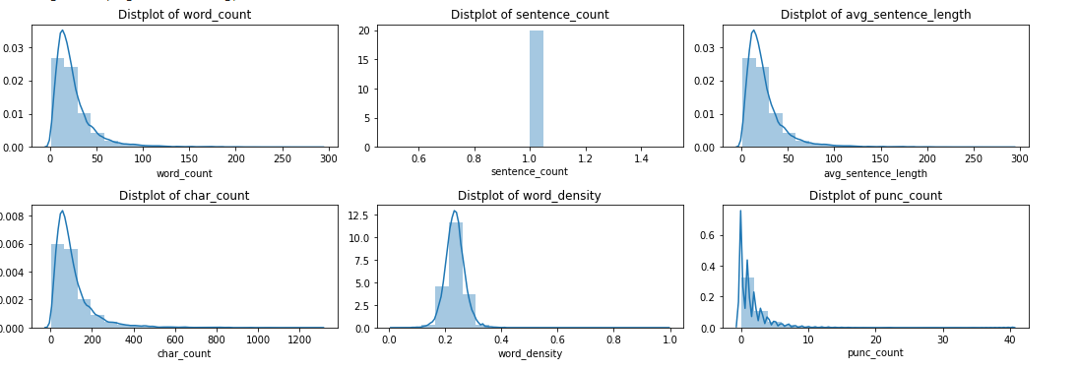
Results
After removing rows where the summarizer was unable to produce a summary, I have a df comprised of 14,868
Notes:
We can see that most answers average around 25

Slide 28
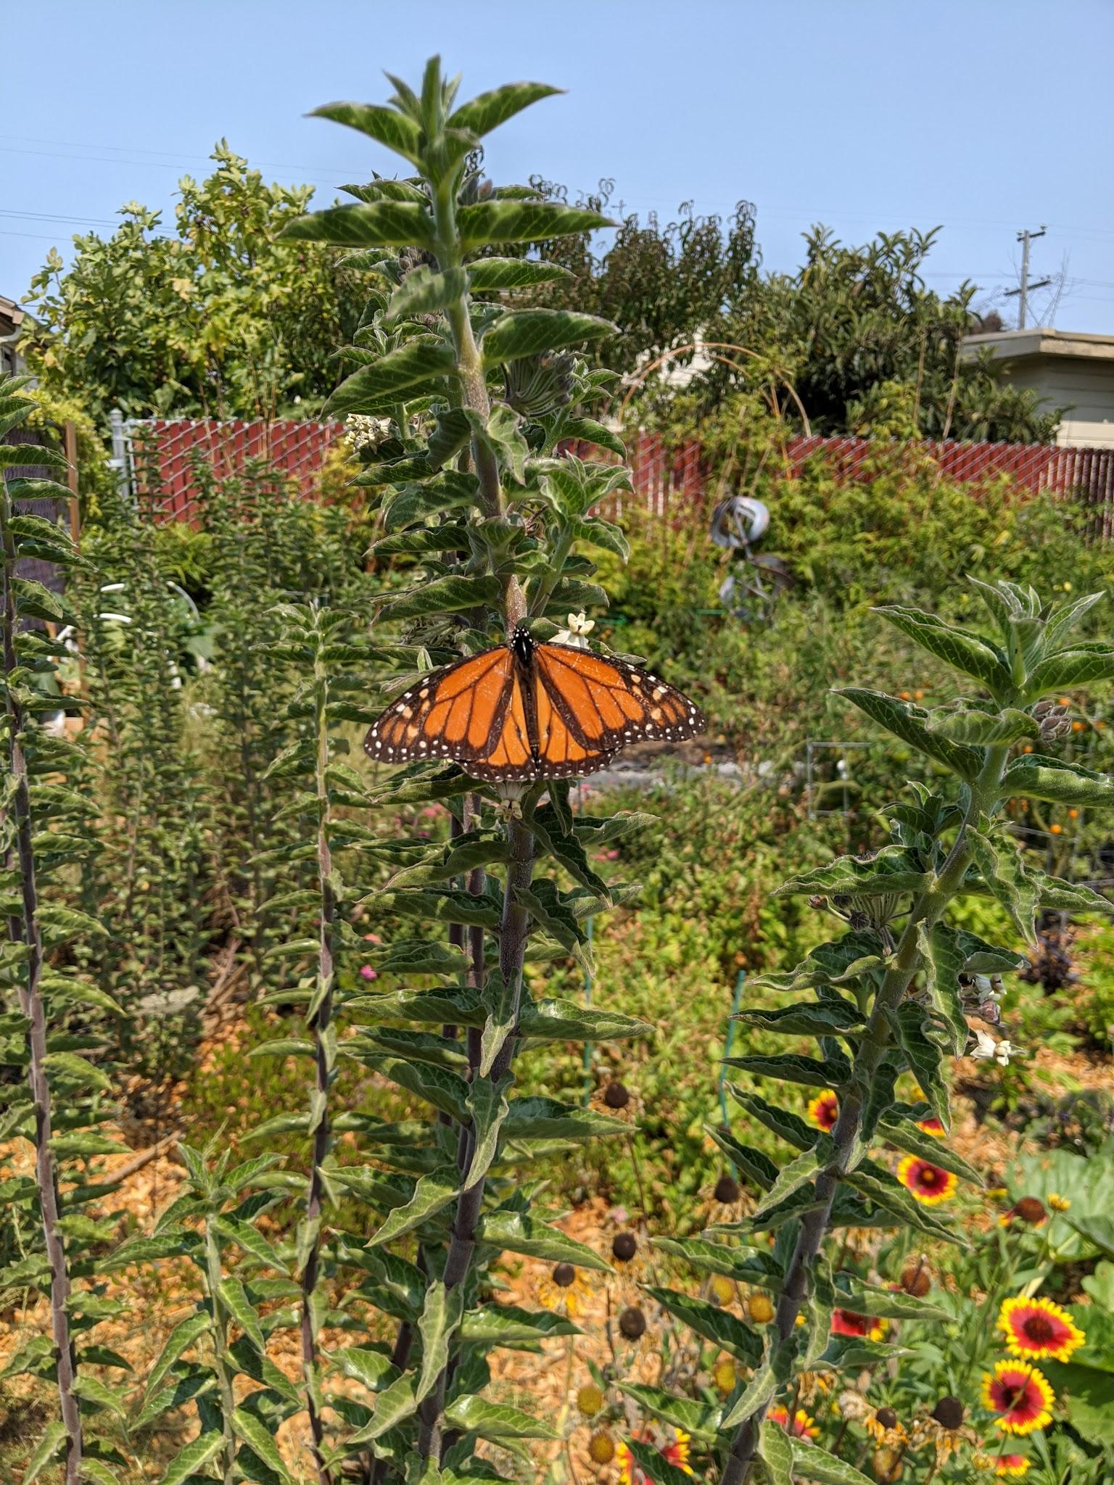
At the end of Step 2
Applied an Extractive Summarizer
My final DF is ready for the chatbot build with the following columns:
Cleaned Question
Summarized Answer
Topic
My final df has 14,868 rows, which is 86% of the original dataset

Slide 29
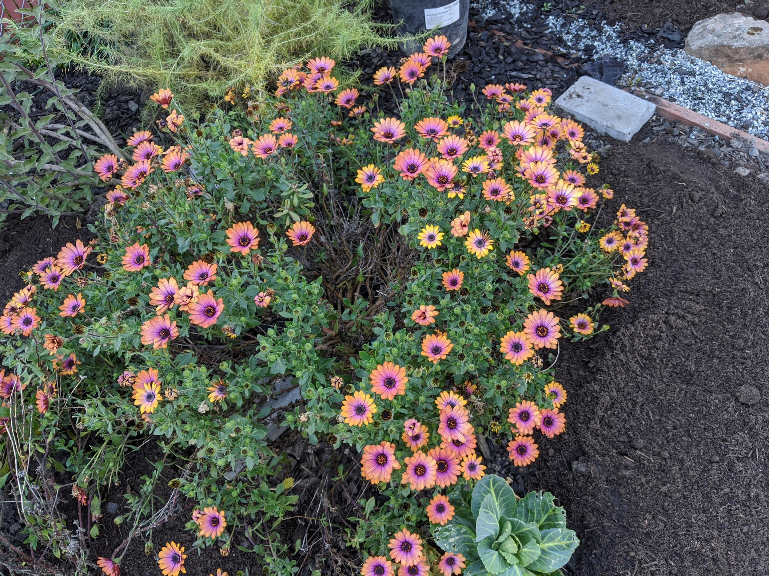
04
Building the ChatBot

Slide 30
Preparing the data for the model
List of Topics
All 10 topics stored in a list
Documents
List of pairs: tokenized and lemmatized questions along with the topic
Words
All distinct words of the questions

Slide 31
Building the Deep Learning Model
Steps for the training data:
Initialization of the training data with a list of bags of words for each of the documents
Shuffle of the training data
Train-test-split with X variable being the bow of the questions and the Y variable being the topics indexed from 0-9

Slide 32
Building the Deep Learning Model
Using Keras Deep learning Sequential model with 3 layers, with the first one having 128 neurons, the second one having 64 neurons, and the third one having the number of topics as the number of neurons.
The point of this network is to be able to predict which topic to choose given some data.
The model is trained with stochastic gradient descent. It is computationally faster than gradient descent and works well when there is redundancy in the data.
After 25 epochs I get : loss: 0.4370 - accuracy: 0.8722
Notes:
In machine learning, the perceptron is an algorithm for supervised learning of binary classifiers. A binary classifier is a function which can decide whether or not an input, represented by a vector of numbers, belongs to some specific class

Slide 33
Sample Conversation with MontyBot:
MontyBot: I can help you with gardening questions!
User: hi
MontyBot: hey
User: how are you
MontyBot: ['i gave the plant the fertilizer that comes in small balls 2-3x couple of tablespoons over the summer']
User: what about aphids?
MontyBot: ['if you see it we will see it many pix in one post otherwise i am usually too lazy to do it myself lol and the one time i do it wont open lol welcome to gw come and visit the perennial and annual forums we need more action ken thanks for the info on how to load pix']
User: when should you water
MontyBot: ['thai basil is my favorite culinary basil']
User: what about pest
MontyBot: ['i have since purchased great wall and smith s best and they survived garaged their first winter shipped in the fall']

Slide 34
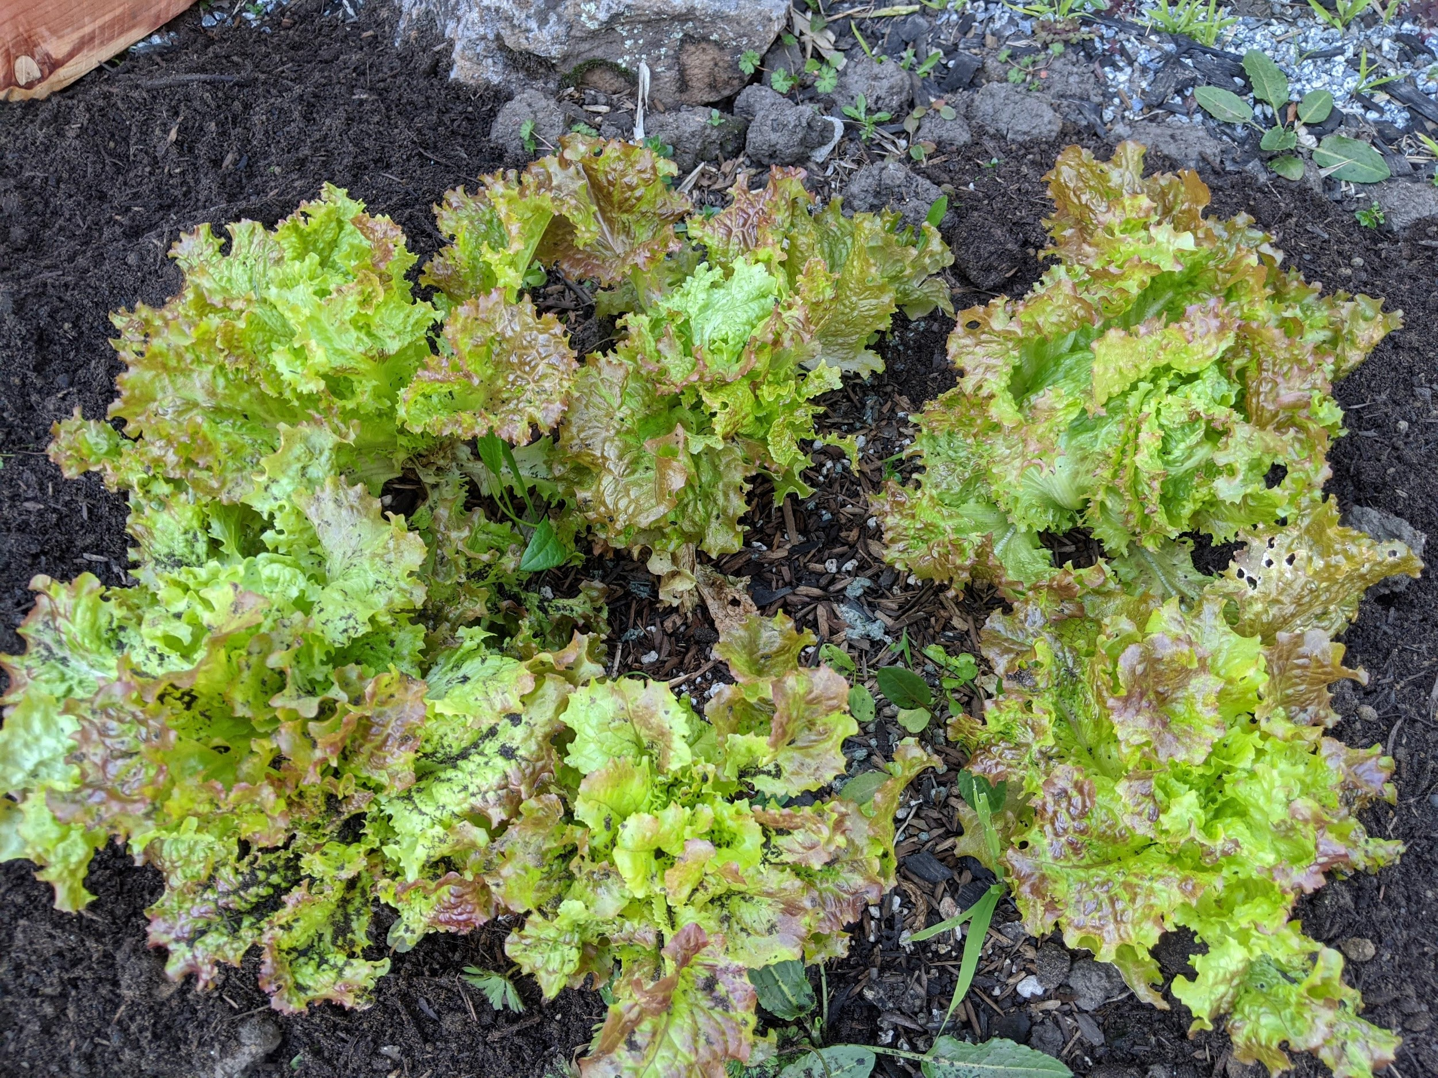
05
Improvements

Slide 35
Improvements
There is DEFINITELY room for improvement!
Here are a few directions:
Data:
The data was scraped and isn't of great quality. More time could be spent finding better data to feed to the models
The data could be further preprocessed and cleaned to try to better prepare for the models
Topic Modeling:
I would like to explore increasing the number of topics or layering multiple topics to one question
I would like to explore other topic modeling models

Slide 36
Improvements cont.
Text Summarization:
Overall the summarization technique that I chose is purely extractive and I would like to successfully (this was attempted during this project) implement abstractive methods such as BERT models.
I would also like to explore other summarization techniques
Chatbot:
I built the chatbot using Deep Learning techniques but the core mechanic is still too broad given that it randomly chooses an answer paired to the topic. There are thousands of answers in each topic therefore it is very likely if not almost certain that it will fail to pick the right one.
I want to explore other chatbot models for example: https://towardsdatascience.com/build-a-simple-chatbot-with-python-and-google-search-c000aa3f73f0

Slide 37
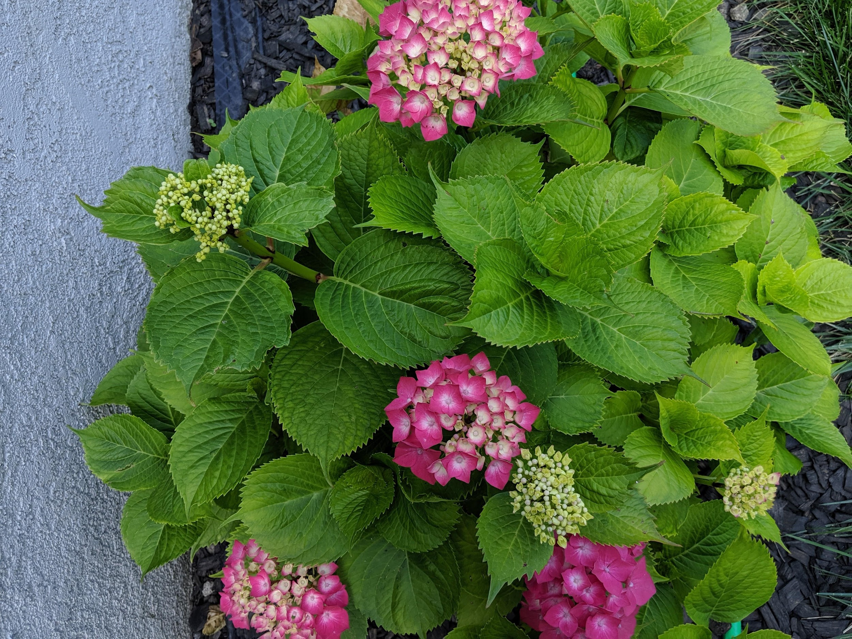
06
Future Developments

Slide 38
Future Developments
This was 100% a passion project that I will continue working on post Thinkful. Amongst the functionalities that I would like this project to have:
A planting recommendation engine to the bot: based on criterias such as water/space/sun, it could give the user a list of plants that would thrive
A personality: I would love for the bot to tell jokes and have a "style"
Image recognition feature: user could submit a picture asking what plant or what disease is present on the plant and the bot would identify it

Slide 39
Sources and reading materials:
Step 1:
https://medium.com/@yanlinc/how-to-build-a-lda-topic-model-using-from-text-601cdcbfd3a6
https://www.objectorientedsubject.net/2018/08/experiments-on-topic-modeling-pyldavis/#:~:text=and%20its%20lift.-,Relevance,ranked%20only%20by%20their%20lift
https://medium.com/@benzgreer/sklearn-lda-vs-gensim-lda-691a9f2e9ab7#:~:text=Sklearn%20was%20able%20to%20run%20all%20steps%20of%20the%20LDA%20model%20in%20.&text=Sklearn%2C%20on%20the%20choose%20corpus,%2DWords%20(BOW)%20documents.
https://www.kaggle.com/morrisb/compare-lda-topic-modeling-in-sklearn-and-gensim
https://www.machinelearningplus.com/nlp/topic-modeling-visualization-how-to-present-results-lda-models/
https://www.machinelearningplus.com/nlp/topic-modeling-python-sklearn-examples/
Step 2:
https://towardsdatascience.com/understand-text-summarization-and-create-your-own-summarizer-in-python-b26a9f09fc70
Step 3:
https://towardsdatascience.com/how-to-create-a-chatbot-with-python-deep-learning-in-less-than-an-hour-56a063bdfc44

Slide 40
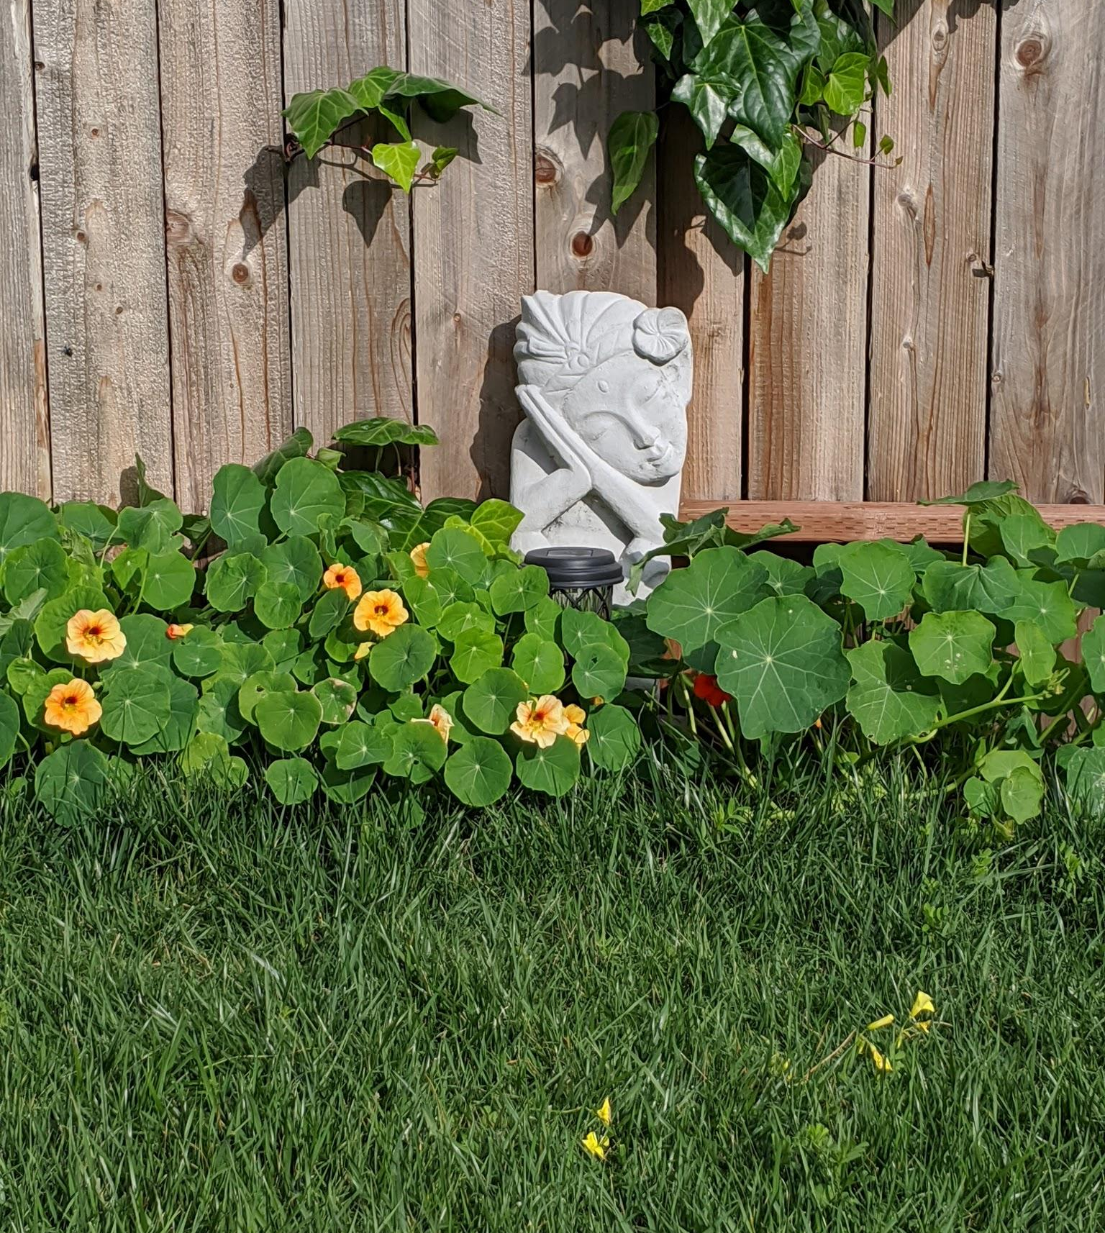
Thanks!
Do you have any questions or suggestions?
ries.nathalie560@gmail.com
Please keep this slide for the attribution

